Slide 1
Presentation 2
Smart Double-network GelMA + HA scaffold with embedded PVDF sensor for cartilage regeneration
TsaiTung (Samantha) Chiang
2nd Dec. 2024
Notes:
Hi. I am Samantha and today I am going to present my design: a Smart Double-Network GelMA and HA Scaffold embedded with a PVDF sensor for cartilage regeneration.

Slide 2
Background and Motivation
Aim
Materials
Methods
Design
Health and failure risks
Regulatory requirements
Outline
Notes:
Here is the outline

Slide 3
Background and Motivation
Patients need to maintain proper movement mechanics and moderate knee usage post-surgery to prevent re-injury.
Current cartilage regeneration scaffolds primarily provide structural support and bioactive environments but lack real-time monitoring capabilities, making it difficult to track mechanical stress and regeneration progress after surgery.
To address these limitations, this project proposes a novel double-network scaffold combining GelMA and HA with an embedded Polyvinylidene Fluoride (PVDF) pressure sensor.
Notes:
First is background and motivation
Cartilage injuries are difficult to repair due to the tissue's limited self-healing capacity. After surgery, patients often require proper movement and moderate knee usage to avoid re-injury, yet current scaffolds focus only on providing structural and bioactive environments.
They lack the capability to monitor real-time mechanical stress or regeneration progress.

Slide 4
Aim
To design a regenerative GelMA-HA scaffold that repairs damaged cartilage and dynamically monitors mechanical stress and recovery progress by integrating a PVDF pressure sensor and a BLE module for real-time data transmission.
Notes:
To address these limitations, I aim to design regenerative GelMA-HA scaffold that repairs damaged cartilage and dynamically monitors mechanical stress and recovery progress by integrating a PVDF pressure sensor and a BLE module for real-time data transmission to a smartphone app.
This design enables dynamic stress monitoring while supporting cartilage regeneration, offering valuable data.

Slide 5
Materials - Biomaterials
1. GelMA (Gelatin Methacrylate)
  GelMA is a photocrosslinkable hydrogel that closely mimics the extracellular matrix (ECM), supporting cell adhesion, proliferation, and extracellular matrix production.
  Its tunable mechanical properties allow the scaffold's stiffness to be adjusted, matching the elasticity needed for cartilage regeneration.
  GelMA’s compatibility with 3D printing makes it ideal for producing patient-specific scaffold structures.
  Its biocompatibility ensures a safe environment for cellular activities and long-term integration with host tissue.
2. HA (Hyaluronic Acid)
  HA is a hydrophilic polysaccharide naturally present in cartilage, playing a vital role in lubrication and bioactivity.
  It stimulates extracellular matrix production and enhances the scaffold’s biological functionality.
  HA complements GelMA’s structural properties by improving flexibility and mimicking the lubricative function of natural cartilage.
  It also promotes better integration between the scaffold and the surrounding tissue.
3. Nanoparticles (Silica):
  Improves mechanical strength and porosity, addressing GelMA's inherent softness.
  Enhances nutrient transport and cell migration within the scaffold.
Notes:
"Let’s begin with the Biomaterials for Double-Network Scaffold
First is GelMA. It mimics the extracellular matrix, promoting cell adhesion and proliferation. Provides photocrosslinkable properties enable precise mechanical tunability to match cartilage elasticity. and also provides biocompatibility and biodegradability.
And then is HA. It enhances flexibility in the scaffold, mimics the natural cartilage, promoting extracellular matrix production. and be Used for its excellent hydrophilicity and biocompatibility.
Lastly is Nanoparticles: It Improves mechanical strength and porosity and enhances nutrient transport and cell migration within the scaffold.
So This multi-layer fabrication ensures a double-network structure. The GelMA base layer provides structural stability, while the HA layer ensures tissue integration.

Slide 6
Materials - Functional materials
1. PVDF (Polyvinylidene Fluoride)
  PVDF is a piezoelectric polymer capable of generating electrical signals under mechanical stress, enabling real-time pressure monitoring.
  It has high stability and flexibility, suitable for detecting dynamic joint activities within a frequency range of 1–10 Hz.
  PVDF provides the unique ability to monitor pressure changes during rehabilitation, bridging the scaffold's regenerative function with intelligent diagnostics.
2. PDMS (Polydimethylsiloxane)
  PDMS is a chemically inert, biocompatible material that provides excellent mechanical stability and flexibility.
  Its hydrophobic nature requires surface modification, such as O₂ plasma treatment, to bond with hydrophilic layers like GelMA.
  PDMS encapsulates electronic components, such as the PVDF sensor, protecting them from the biological environment while maintaining biocompatibility.
GelMA, HA, and PDMS are the backbone of this scaffold, supporting cartilage regeneration with their structural and biological properties. PVDF complements these biomaterials by adding a monitoring capability, ensuring the scaffold addresses both regenerative and diagnostic needs.
→ This combination highlights how biomaterials and functional materials can work together to create a comprehensive
solution for cartilage repair.
Notes:
Here is the functional materials.
So first PVDF is a piezoelectric (匹欸zo electric) polymer that generates electrical signals under mechanical stress. This allows the scaffold to monitor pressure changes in real time.
And PDMS encapsulates the PVDF sensor and other electronic components, protecting it from moisture and ensuring biocompatibility. The sensor monitors mechanical stress, transmitting data wirelessly via BLE.

Slide 7
Methods
Layer 1: GelMA + Nanoparticle Base
  Prepare GelMA solution (5%-10% w/v) with photoinitiator and mix with HA (1%-2% w/v) and silica nanoparticles (1%-5% w/v).
  Print using Digital Light Processing (DLP) 3D printing to ensure consistent pore size and structural integrity.
  Embed PDMS-encapsulated electronic component during printing.
  Perform UV crosslinking (365 nm, 2-5 minutes) to solidify the layer.
Layer 2: HA Flexible Network
  Immerse the crosslinked base layer in HA solution (1%-3% w/v, with EDC/NHS as crosslinking agents).
  Allow chemical crosslinking at room temperature for 4-6 hours.
Notes:
The scaffold consists of two layers:
Layer 1 is GelMA + Nanoparticle Base: The solution will contain GelMA, HA and nanoparticles. During printing, the PDMS-encapsulated PVDF sensor is embedded within the GelMA base. UV crosslinking solidifies the structure, ensuring proper integration
And in Layer 2 is HA Flexible Network: The crosslinked GelMA base layer, which is the first layer, is immersed in HA solution, containing crosslinking agents. Do Chemical crosslinking to form a stable network that enhances flexibility and bioactivity.

Slide 8
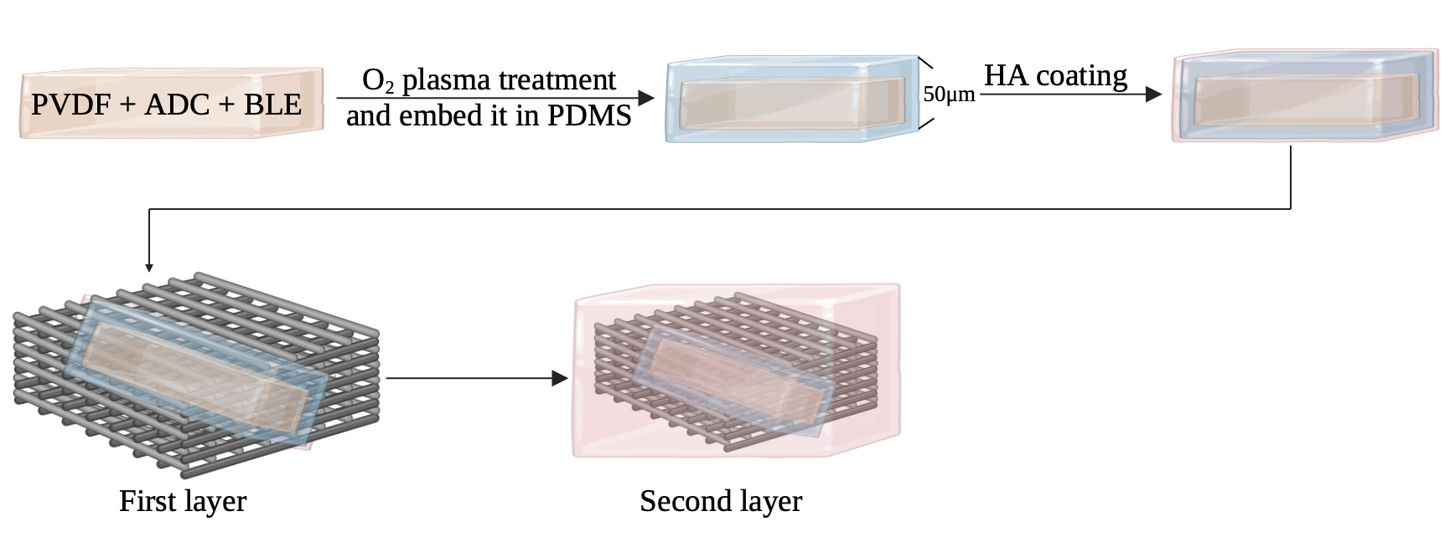
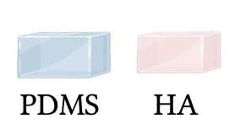
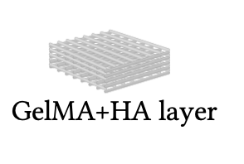
Methods
Notes:
I think maybe This diagram that I draw by using biorender will be more clear to illustrate the scaffold’s functional design.
This is not the actual synthesis, its just a Schematic (死鴿metic) diagram, so don’t worry too much about the shape.
Ok. So here in the diagram the orange part is the electronic components and then do plasma treatment for surface modification and embed it in PDMS for protection, and the thickness of it will be around 50 micrometers. It achieves the isolation function without affecting the accuracy of the PVDF sensor.
And then do HA coating.
During 3D printing, the PDMS-encapsulated PVDF sensor is embedded within the GelMA base. UV crosslinking solidifies the structure, ensuring proper integration. Then it will be immersed in HA solution and do Chemical crosslinking to form a stable network.
Length and width:
Diameter: 10-30 mm, designed as a round or oval structure according to the defect location.
Thickness: 1-3 mm, ensuring a double network layer containing GelMA and HA, as well as a protective layer of PVDF and PDMS elements.
PVDF pressure sensor size:
Typically thin films are used, with a thickness of approximately 10-50 μm (thinner 10 μm is recommended for increased sensitivity).
The length and width should be smaller than the entire stent area (e.g. 5-10 mm) to ensure that the pressure distribution can be accurately sensed.
PDMS wrapping layer:
The thickness should be controlled at 0.1-0.2 mm, which can protect electronic components without affecting their sensitivity.
Overall design reference:
Device design should be within the range of 15-30 mm (diameter) × 1.5-3 mm (thickness), adjusted according to actual patient conditions.

Slide 9
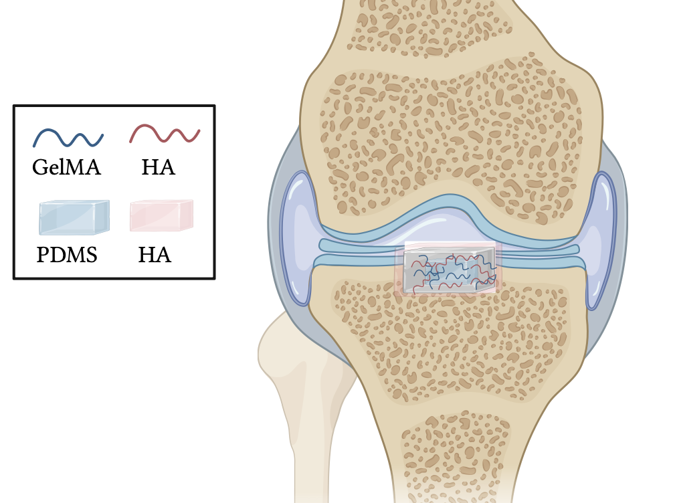
Schematic diagram of the design
Force
Force
Notes:
So actually the device will be a circular shape with a diameter within 1 cm and a 1-3 mm thickness.
The illustration shows the device implanted in a knee joint, positioned within the defect area of the cartilage, during surgey. (按) This placement ensures direct interaction with surrounding tissues to promote cartilage regeneration.
（按）The scaffold experiences vertical forces during weight-bearing activities such as walking, running, and jumping. These dynamic mechanical stresses are monitored in real-time by the PVDF pressure sensor embedded in the scaffold

Slide 10
Health and failure risks
Biocompatibility Concerns:
Non-biodegradable components such as PDMS and PVDF present potential long-term risks as they remain in the body after their functional lifespan. Unlike biodegradable materials that naturally degrade and are absorbed by the body, these components may lead to chronic inflammatory responses, fibrosis, or encapsulation by surrounding tissues over time.
Infection Risk:
As the device is implantable, there is a risk of infection during or after surgery.
Sensor Accuracy:
PDMS encapsulation may reduce the sensitivity of the PVDF pressure sensor. Additionally, improper placement or material thickness could affect the accuracy of pressure readings. Signal interference or loss during BLE data transmission could lead to incomplete or incorrect monitoring results.
Long-Term Implantation Risks:
Non-biodegradable components such as PDMS and PVDF, if left in the body, could lead to long-term issues like fibrosis or device encapsulation by surrounding tissues.
Notes:
Despite its advantages, this design poses some risks:
Biocompatibility:
Non-biodegradable components such as PDMS and PVDF present potential long-term risks as they remain in the body after their functional lifespan. Unlike biodegradable materials, such as GelMA and HA, that naturally degrade and are absorbed by the body, these non-biodegradable components may lead to inflammatory responses or encapsulation by surrounding tissues over time
Infection Risk: As an implantable device, the surgical procedures are essential to minimize infection.
Sensor Accuracy: PDMS encapsulation could reduce sensor sensitivity, and improper placement or material thickness might affect pressure readings. BLE transmission could also experience signal interference.
As I mentioned, Non-biodegradable components such as PDMS and PVDF, if left in the body, could lead to long-term risks.
These risks must be addressed through testing and design optimization.

Slide 11
Regulatory requirements
Risk Analysis: Conduct comprehensive risk management in accordance with ISO 14971 standards to identify, evaluate, and mitigate potential risks associated with the device.
Performance Testing: Assess the accuracy and reliability of the PVDF pressure sensor and BLE module under various operational conditions.
Durability Testing: Evaluate the mechanical properties of the scaffold, including compressive strength, fatigue resistance, and interlayer bonding stability, to ensure structural integrity over time.
Preclinical Testing: Perform preclinical studies using animal models to assess the scaffold’s biological performance, including its biocompatibility, regenerative potential, and overall safety.
Usability Testing: Validate the functionality and reliability of the BLE module’s data transmission under real-world conditions to ensure accurate and consistent performance.
Class III because it is an implantable device that incorporates electronic components such as a PVDF pressure sensor and a BLE module. Devices in this category require rigorous safety and performance testing, along with the submission of comprehensive technical documentation. This includes compliance with standards such as ISO 10993 for biocompatibility testing, ensuring that the materials and the overall device do not induce cytotoxicity, irritation, or long-term adverse reactions in a biological environment.
Notes:
To comply with FDA or Health Canada regulatory (ㄖㄨㄟ gu了ㄊㄜˇry) requirements, the following documentation and testing must be completed. And because this device is an implantable device that incorporates electronic components such as a PVDF pressure sensor and a BLE module, it is classified as Class III.

Slide 12
Conclusion
In conclusion, this Smart Double-Network Scaffold combines GelMA and HA for cartilage regeneration with PVDF for real-time pressure monitoring. It addresses both structural and diagnostic challenges in cartilage repair, providing valuable data to optimize patient outcomes.
Notes:
In conclusion, this Smart Double-Network Scaffold combines GelMA and HA for cartilage regeneration with PVDF for real-time pressure monitoring. It addresses both structural and diagnostic (戴爾格納斯提克) challenges in cartilage repair, providing valuable data to optimize patient outcomes.

Slide 13
References
[1] Jacob, J., More, N., Kalia, K. et al. Piezoelectric smart biomaterials for bone and cartilage tissue engineering. Inflamm Regener 38, 2 (2018).
[2] Burdick, J. A., & Prestwich, G. D. (2011). Hyaluronic acid hydrogels for biomedical applications. Advanced Materials, 23(12), H41–H56.
[3] Lee, K. Y., & Mooney, D. J. (2012). Alginate: properties and biomedical applications. Progress in Polymer Science, 37(1), 106–126
[4] Lin, C. C., & Anseth, K. S. (2009). PEG hydrogels for the controlled release of biomolecules in regenerative medicine. Pharmaceutical Research, 26(3), 631–643.
[5] Woodruff, M. A., & Hutmacher, D. W. (2010). The return of a forgotten polymer—Polycaprolactone in the 21st century. Progress in Polymer Science, 35(10), 1217–1256.
[6] Makadia, H. K., & Siegel, S. J. (2011). Poly Lactic-co-Glycolic Acid (PLGA) as biodegradable controlled drug delivery carrier. Polymers, 3(3), 1377–1397.
[7] Yue, K., Trujillo-de Santiago, G., Alvarez, M. M., Tamayol, A., Annabi, N., & Khademhosseini, A. (2015). Synthesis, properties, and applications of gelatin methacryloyl (GelMA) hydrogels. Biomaterials, 73, 254–271.
[8] Akbari, S., Khazaeinejad, P. Geometrical and mechanical analysis of polylactic acid and polyvinylidine fluoride scaffolds for bone tissue engineering. Engineering with Computers 39, 4153–4165 (2023). [9] Z. Wang, S. Han, B. Zhou, C. Xu and S. Chen, "Flexible Piezoelectric Sensor with a Sandwich Structure Composed of Ionic Conductive Hydrogel and PVDF Film," in IEEE Sensors Journal, vol. 24, no. 13, pp. 21339-21346, 1 July1
[10] Anbo Zheng, Yuxiang Qin, Qing Xia, Xueshuo Zhang, and Yanxu Chen, ACS Applied Polymer Materials 2023 5 (4), 2312-2322

Slide 14

Thank you!
Please feel free to ask any questions you may have.

